Slide 1
AI-Driven Adaptive Diagnostic Engine 1-Dimensional Adaptive Testing Prototype
Name: Kishan Bhalani Tech Stack: Python, FastAPI, MongoDB, Groq API

Slide 2
Problem Statement
Problem:
Most traditional quizzes give the same set of questions to every student. However, students have different skill levels, so a fixed quiz cannot accurately measure their true ability.
If the questions are too easy, the test does not challenge the student. If they are too difficult, the student may struggle and lose confidence.
Goal:
The goal of this project is to build an adaptive testing system that can adjust the difficulty of questions based on the student’s performance.
By doing this, the system can better estimate the student’s ability level and identify the topics where the student needs more practice.

Slide 3
System Overview
This system works by dynamically selecting questions based on how the student performs during the quiz.
First, the student starts a quiz session. The system selects a question based on the student’s current estimated ability level.
After the student answers the question, the system checks whether the answer is correct or incorrect. Based on this result, the system updates the student’s ability score.
The next question is then selected with a difficulty level that matches the updated ability score.
Once the quiz ends, the system analyzes the student’s incorrect answers and identifies weak topics. These weak topics are then used to generate a personalized learning plan using an AI model.

Slide 4
Tech Stack
For this project, I used Python with FastAPI to build the backend API. FastAPI was chosen because it is lightweight, easy to use, and automatically generates interactive API documentation.
For the database, I used MongoDB, which is well suited for storing flexible data structures like quiz questions with metadata such as topic, difficulty, and tags.
To run the API server, I used Uvicorn, which is a fast ASGI server designed for Python web applications.
For the AI component, I integrated the Groq API, which uses a large language model to generate personalized learning recommendations based on the student’s performance.

Slide 5
Database Design
The system stores quiz questions in a MongoDB collection.
Each question contains several important pieces of information such as the question text, available answer options, the correct answer, the difficulty level, and the topic.
The difficulty value ranges from 0.1 to 1.0, where lower values represent easier questions and higher values represent more difficult questions.
This metadata allows the adaptive algorithm to select questions that are appropriate for the student’s current ability level.
By organizing the data in this way, the system can easily filter and retrieve questions based on difficulty and topic.

Slide 6
User Session Model
To track a student's progress during the quiz, the system uses a UserSession collection.
Each session stores information such as the session ID, the student’s current ability score, and the answers submitted during the quiz.
The ability score represents the system’s estimate of the student’s skill level.
At the beginning of the quiz, the ability score starts at a neutral value. As the student answers questions, the score is updated based on whether the answers are correct or incorrect.
This allows the system to continuously adjust the difficulty of the questions being asked.

Slide 7
Adaptive Algorithm
The adaptive algorithm is the core part of this system.
At the start of the quiz, the student begins with a baseline ability score of 0.5.
When a student answers a question correctly, it indicates that the question may have been too easy. In this case, the system slightly increases the ability score and selects a more difficult question next.
If the student answers incorrectly, it indicates that the question may have been too difficult. The system then decreases the ability score and selects an easier question.
By repeating this process, the system gradually moves toward a difficulty level that matches the student’s true ability.

Slide 8
Adaptive Algorithm Flow
The process begins when the student starts the quiz.
The system assigns an initial ability score and selects a question that matches this difficulty level.
The student answers the question, and the system evaluates whether the answer is correct.
If the answer is correct, the ability score increases slightly. If the answer is incorrect, the ability score decreases.
Based on the updated ability score, the system selects the next question with an appropriate difficulty level.
This process continues for several questions until the quiz session is completed.

Slide 9
Weak Topic Detection
While the quiz is running, the system also keeps track of the topics where the student makes mistakes.
Whenever a student answers a question incorrectly, the system records the topic associated with that question.
At the end of the quiz, the system analyzes all incorrect answers and counts how many mistakes were made in each topic.
Topics with the highest number of incorrect answers are considered the student’s weak areas.
These weak topics are then used to generate personalized learning recommendations.

Slide 10
AI Integration
To make the system more helpful, I integrated an AI model using the Groq API.
Once the quiz is completed, the system sends the student’s performance data to the AI model. This data includes the weak topics and the difficulty levels reached during the quiz.
The AI model analyzes this information and generates a short three-step study plan that helps the student improve in the areas where they struggled the most.
This allows the system to go beyond just showing quiz results and instead provide meaningful learning guidance.

Slide 11
API Design
The system exposes several API endpoints that allow users to interact with the quiz engine.
The next question endpoint retrieves a question based on the student’s current ability score.
The submit answer endpoint receives the student’s answer and evaluates whether it is correct or incorrect.
Finally, the learning plan endpoint analyzes the student’s performance and returns a personalized study plan generated by the AI model.
FastAPI automatically generates interactive API documentation using Swagger, which makes it easy to test these endpoints.

Slide 12
Example API Response
When the system returns a question, it includes the question text and the available answer options.
After the student submits an answer, the system returns a response indicating whether the answer was correct and the topic associated with that question.
These responses allow the frontend or testing interface to display results to the user and update the quiz flow accordingly.

Slide 13
Demo
In the demonstration, I will show how the system works in practice.
First, I will show the MongoDB database containing the quiz questions.
Next, I will start the FastAPI server and open the API documentation page.
From there, I will demonstrate how the endpoints work by requesting questions and submitting answers.
Finally, I will show how the system generates a personalized learning plan using the AI model based on the student’s performance.

Slide 14
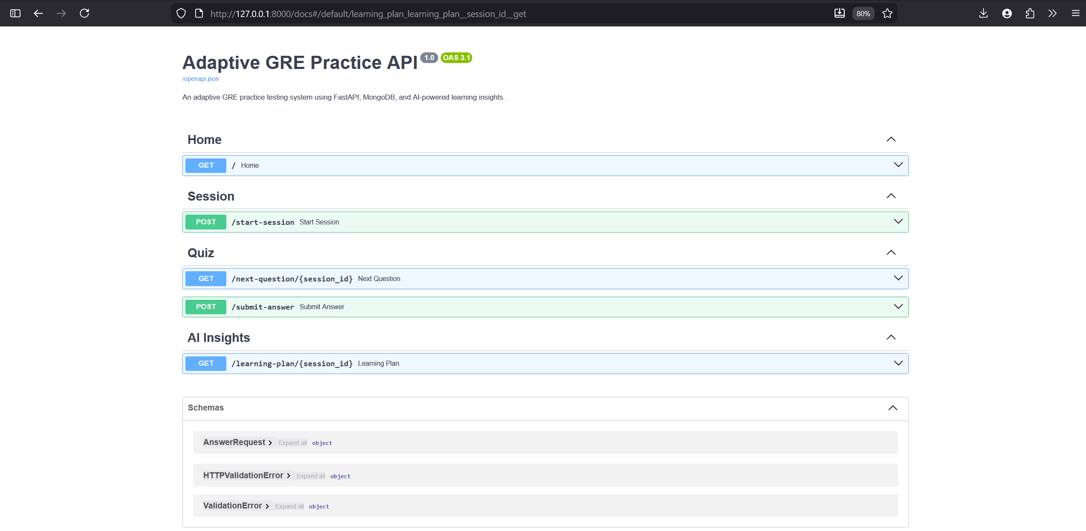

Conclusion
HomePage – Adaptive GRE practice

Slide 15
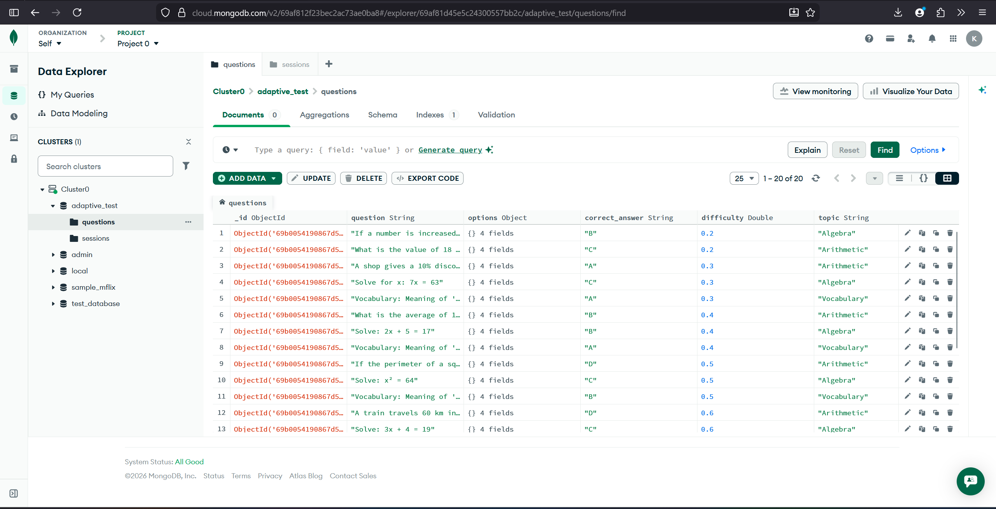
Sample GRE Questions with options

Slide 16
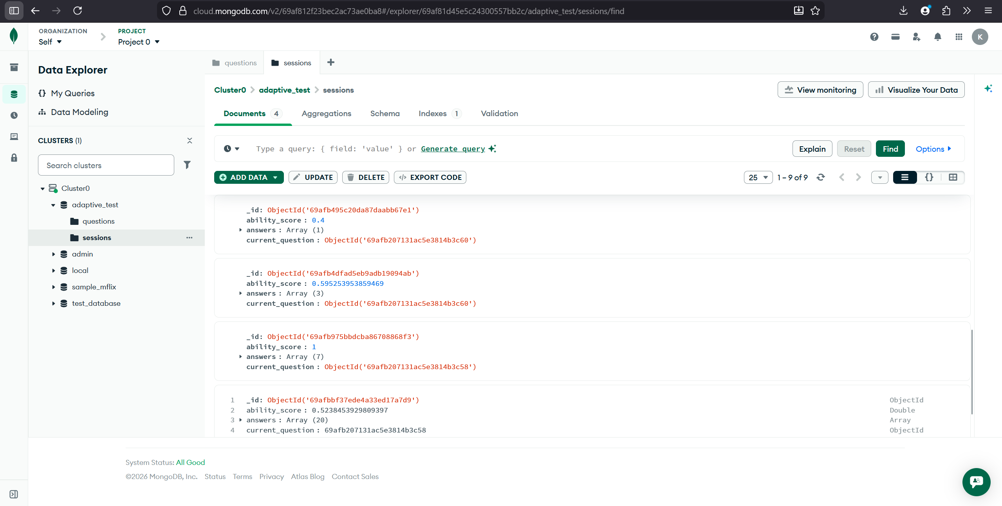



Slide 17
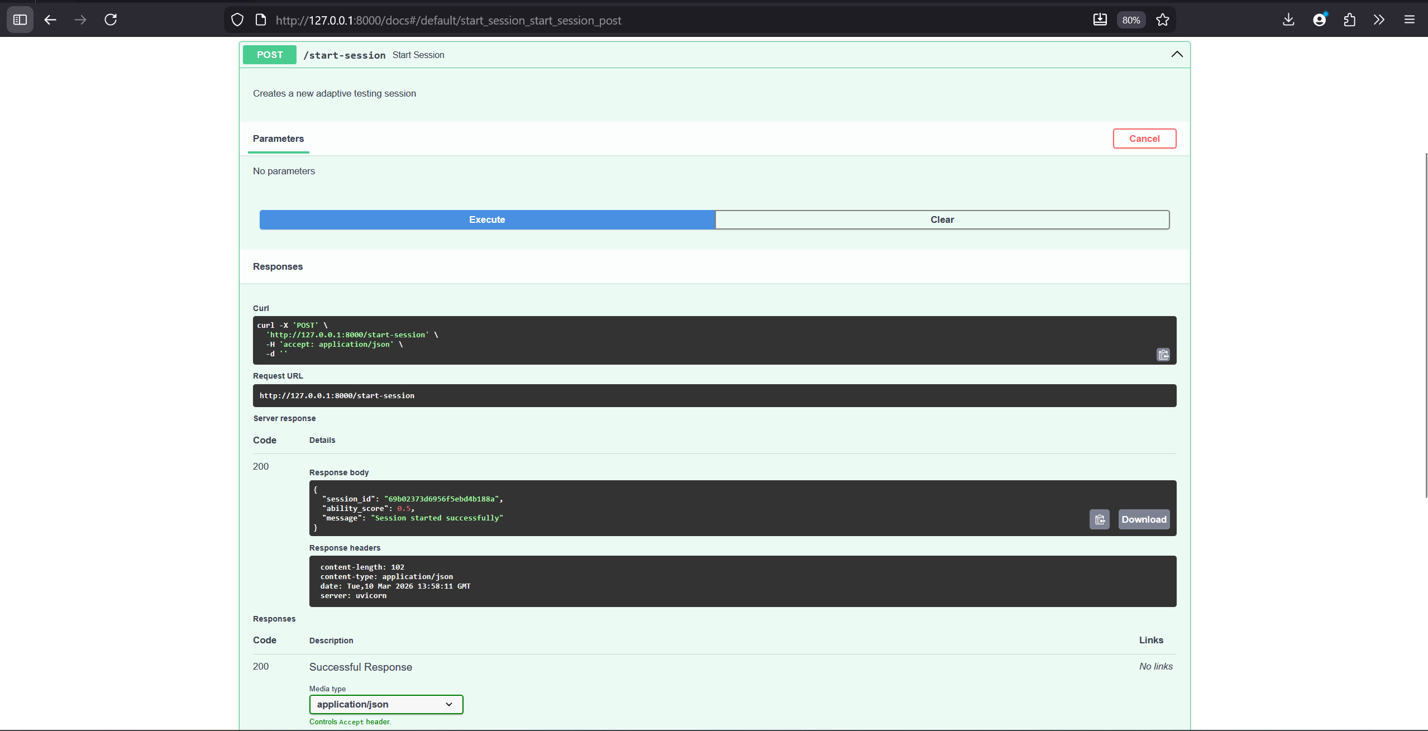

Start Session - UI _ FastAPI
Session ID

Slide 18
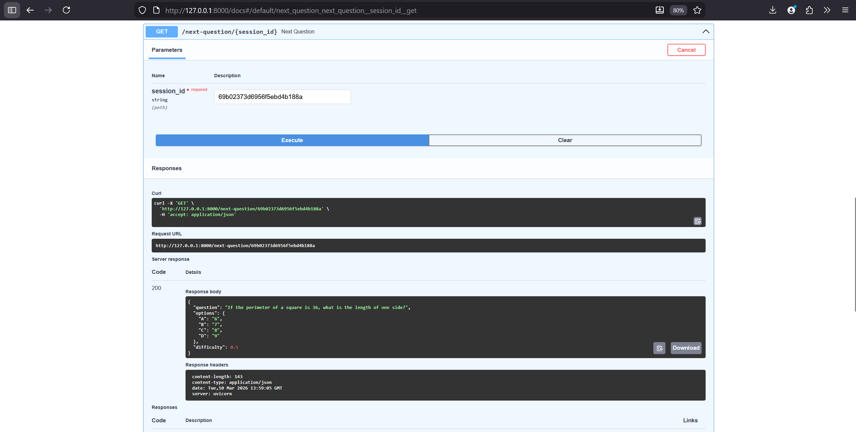
Question/Session - UI _ FastAPI

Slide 19
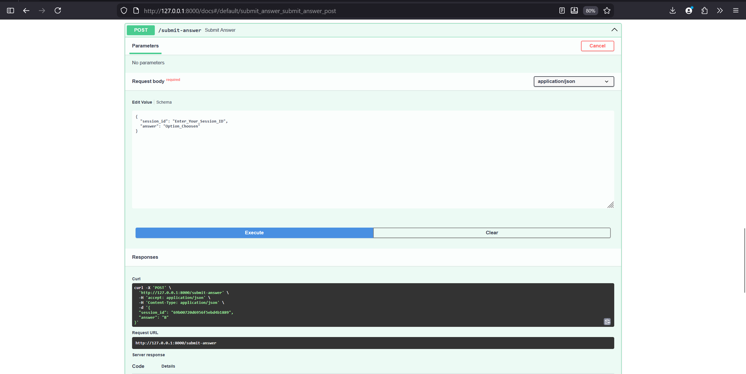
Answer Submission - UI _ FastAPI

Slide 20
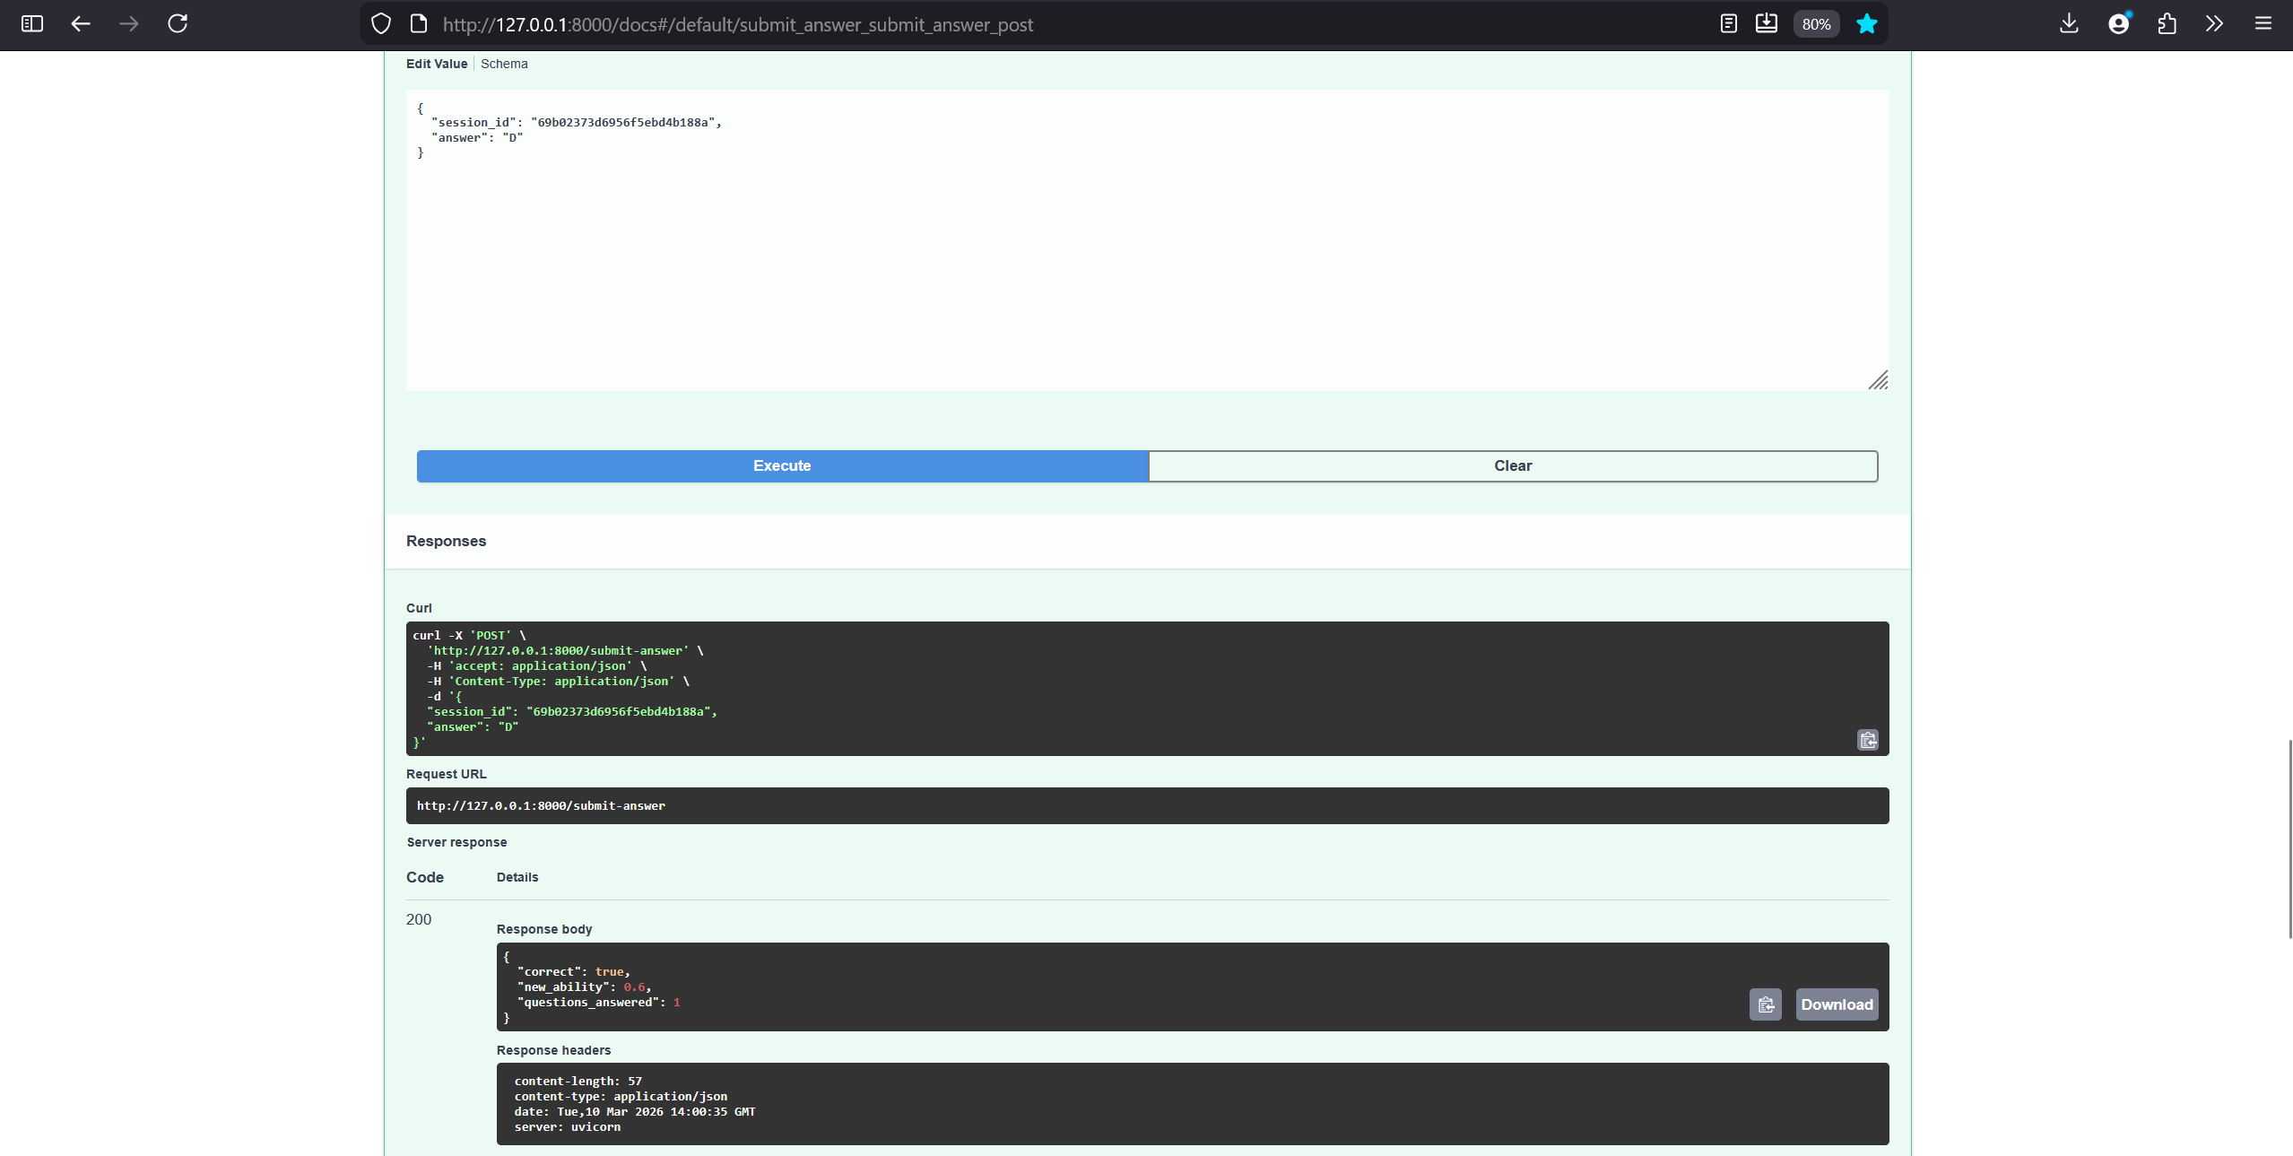
Session ID & Option Selector
Answer Detail’s

Slide 21
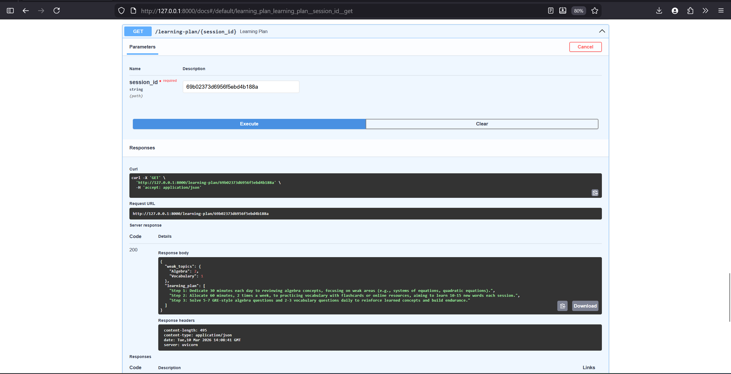
LLM generated learning_plan @ GroqAPI’s

Slide 22
AI Tools Used
Used OpenAI ChatGPT as a coding assistant for generating FastAPI code, structuring modules, and debugging issues.
Integrated Groq API (Grok model) to generate personalized learning plans based on weak topics.
AI tools helped speed up development, but debugging, testing the adaptive logic, and system design decisions were handled manually.

Slide 23
Future Improvements
Although this prototype works well, there are several ways it could be improved.
One improvement would be implementing a more advanced Item Response Theory (IRT) model to estimate student ability more accurately.
Another improvement would be storing long-term user performance data so that the system can track progress over time.
Additional features such as user authentication, a frontend dashboard, and advanced analytics could also make the system more powerful and user-friendly.

Slide 24
Conclusion
This project demonstrates how adaptive algorithms and AI can be combined to build smarter learning systems.
By dynamically adjusting question difficulty and analyzing student performance, the system can estimate ability levels more accurately than traditional quizzes.
The integration of an AI model further enhances the system by providing personalized study recommendations.
Overall, this prototype shows how technology can be used to create more effective and personalized educational experiences.

